Slide 1
Ch2 : DATA MODELS

Slide 2
Data Model is a logical structure of Database. It describes the design of database to reflect entities, attributes, relationship among data, constraints etc.
Data Model can be defined as an integrated collection of concepts for describing and manipulating data, relationships between data, and constraints on the data in an organization.
The purpose of a data model is to represent data and to make the data understandable.

Slide 3
BUSINESS RULES
Business rules are defined as the specifications that preserve the integrity of the logical data model.
The four basic types of business rules are given below :
i) Entity Integrity : Each instance of an entity type must have a unique identifier that is not null.
ii) Referential Integrity Constraints : The rules concerning the relationship between entity types.
iii) Domains : The constraints on valid values for attributes.
iv) Triggering Operations : It aims at protecting the validity of attribute values.

Slide 4
BUILDING BLOCKS OF DATA MODEL
There are four building blocks of data model, which are listed as :
1. Entity
2. Attribute
3. Relationship
4. Constraints

Slide 5

1. Entity: An entity is a person, place, thing or event about which the data are to be collected and stored. An entity is the fundamental item in any data model as it is distinguishable i.e. each entity occurrence is unique and distinct. For e.g.: CUSTOMER, STUDENT etc.
Attribute: An attribute is the characteristic of any entity. For e.g.: CUSTOMER entity can be described by attribute such as name, phone, address, gender. Each attribute is associated with a set off values called domain.
3. Relationship: A relationship describes an association among entities. For e.g.: Relationship exists between publisher and book can be described as: Many books are published by a publisher.
4. Constraints: A constraint is a restriction placed on the data to ensure the integrity and consistency of the database. They are the rules or checks according to which the data is forced to be inserted in the database.

Slide 6
Types of Data Models
• Object Based Data Models • Record Based Data Models

Slide 7
Object based Data Models
In object based data models, the focus is on how data is represented. The data is divided into multiple entities each of which have some defining characteristics. Moreover, these data entities are connected with each other through some relationships.
An object data model is a data model based on object-oriented programming, associating methods (procedures) with objects that can benefit from class hierarchies. Thus, “objects” are levels of abstraction that include attributes and behavior. Some examples of object based data models are
Entity Relationship Data Model
Object Oriented Data Model
Semantic Data Model
Functional Data Model

Slide 8
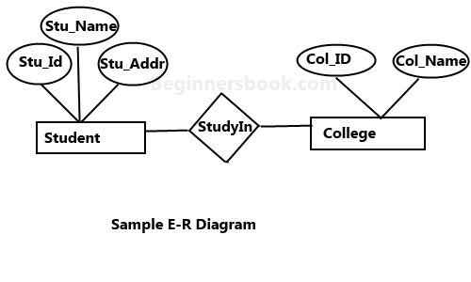
Entity Relationship Model
An ER diagram shows the relationship among entity sets. An entity set is a group of similar entities and these entities can have attributes. In terms of DBMS, an entity is a table or attribute of a table in database, so by showing relationship among tables and their attributes, ER diagram shows the complete logical structure of a database.

Slide 9
Advantages
Exceptional conceptual simplicity
Visual representation
Effective communication tool
Integrated with the relational data model

Slide 10
Disadvantages
Limited constraint representation
Limited relationship representation
No data manipulation language
Loss of information content

Slide 11
Record Based Logical Models
Record based logical models are used in describing data at the logical and view levels. In contrast to object based data models, they are used to specify the overall logical structure of the database and to provide a higher-level description of the implementation.
Record based models are so named because the database is structured in fixed format records of several types. Each record type defines a fixed number of fields, or attributes, and each field is usually of a fixed length.
The three most widely accepted record based data models are:
Hierarchical Model
Network Model
Relational Model

Slide 12
Hierarchical Model
This database model organises data into a tree-like-structure, with a single root, to which all the other data is linked. The hierarchy starts from the Root data, and expands like a tree, adding child nodes to the parent nodes.
In this model, a child node will only have a single parent node.
This model efficiently describes many real-world relationships like index of a book, recipes etc.
In hierarchical model, data is organised into tree-like structure with one-to-many relationship between two different types of data, for example, one department can have many courses, many professors and of-course many students.

Slide 13
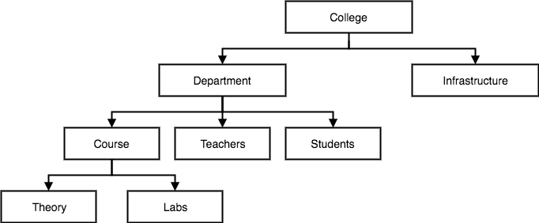

Slide 14
Advantage
1. Simplicity
Data naturally have hierarchical relationship in most of the practical situations. Therefore, it is easier to view data arranged in manner. This makes this type of database more suitable for the purpose.
2. Security
These database system can enforce varying degree of security feature unlike flat-file system.
3. Database Integrity
Because of its inherent parent-child structure, database integrity is highly promoted in these systems.
4. Efficiency: The hierarchical database model is a very efficient, one when the database contains a large number of I: N relationships (one-to-many relationships) and when the users require large number of transactions, using data whose relationships are fixed.

Slide 15
Disadvantages
1. Complexity of Implementation: The actual implementation of a hierarchical database depends on the physical storage of data. This makes the implementation complicated.
2. Difficulty in Management: The movement of a data segment from one location to another cause all the accessing programs to be modified making database management a complex affair.
3. Complexity of Programming: Programming a hierarchical database is relatively complex because the programmers must know the physical path of the data items.
4. Poor Portability: The database is not easily portable mainly because there is little or no standard existing for these types of database.
5. Database Management Problems: If you make any changes in the database structure of a hierarchical database, then you need to make the necessary changes in all the application programs that access the database. Thus, maintaining the database and the applications can become very difficult.
6. Lack of structural independence: Structural independence exists when the changes to the database structure does not affect the DBMS's ability to access data. Hierarchical database systems use physical storage paths to navigate to the different data segments. So, the application programs should have a good knowledge of the relevant access paths to access the data. So, if the physical structure is changed the applications will also have to be modified. Thus, in a hierarchical database the benefits of data independence are limited by structural dependence.

Slide 16
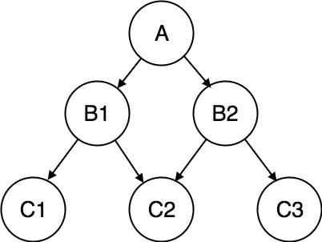
Network Model
In the network data model, data are represented by collections of records. Relationships among data are represented by links. In this data model, graph data structure is used. It permits a record to have more than one parent.

Slide 17
Advantages of Network data model
Conceptual simplicity-Just like the hierarchical model,the network model is also conceptually simple and easy to design.
Capability to handle more relationship types-The network model can handle the one to many and many to many relationships which is real help in modeling the real life situations.
Ease of data access-The data access is easier and flexible than the hierarchical model.
Data integrity- The network model does not allow a member to exist without an owner.
Data independence- The network model is better than the hierarchical model in isolating the programs from the complex physical storage details.

Slide 18
Disadvantages
System complexity- All the records are maintained using pointers and hence the whole database structure becomes very complex.
Operational Anomalies- The insertion, deletion and updating operations of any record require large number of pointers adjustments.
Absence of structural independence-structural changes to the database is very difficult.

Slide 19
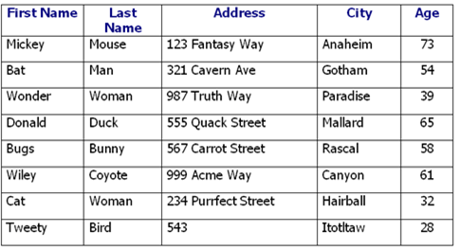
Relational Model
Relational model is the most popular model and the most extensively used model. In this model the data can be stored in the tables and this storing is called as relation, the relations can be normalized and the normalized relation values are called atomic values. Each row in a relation contains unique value and it is called as tuple, each column contains value from same domain and it is called as attribute.

Slide 20
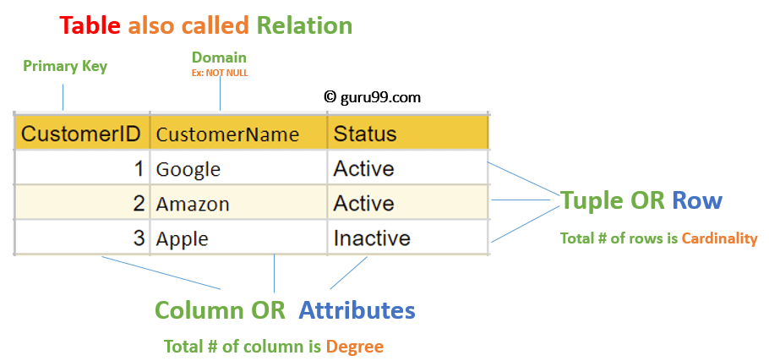
Relational Model Concepts
Attribute: Each column in a Table. Attributes are the properties which define a relation. e.g., CustomerID, CustomerName,etc.
Tables – In the Relational model the, relations are saved in the table format. It is stored along with its entities. A table has two properties rows and columns. Rows represent records and columns represent attributes.
Tuple – It is nothing but a single row of a table, which contains a single record.
Relation Schema: A relation schema represents the name of the relation with its attributes.
Degree: The total number of attributes which in the relation is called the degree of the relation.
Cardinality: Total number of rows present in the Table.
Column: The column represents the set of values for a specific attribute.
Relation instance – Relation instance is a finite set of tuples in the RDBMS system. Relation instances never have duplicate tuples.
Relation key - Every row has one, two or multiple attributes, which is called relation key.
Attribute domain – Every attribute has some pre-defined value and scope which is known as attribute domain

Slide 21
Advantages of using Relational model
Simplicity: A relational data model is simpler than the hierarchical and network model.
Structural Independence: The relational database is only concerned with data and not with a structure. This can improve the performance of the model.
Easy to use: The relational model is easy as tables consisting of rows and columns is quite natural and simple to understand
Query capability: It makes possible for a high-level query language like SQL to avoid complex database navigation.
Data independence: The structure of a database can be changed without having to change any application.
Scalable: Regarding a number of records, or rows, and the number of fields, a database should be enlarged to enhance its usability.
Disadvantages of using Relational model
Few relational databases have limits on field lengths which can't be exceeded.
Relational databases can sometimes become complex as the amount of data grows, and the relations between pieces of data become more complicated.
Complex relational database systems may lead to isolated databases where the information cannot be shared from one system to another.

Slide 22
Comparison between hierarchical, network and relational model
Sr. No. | Hierarchical | Network | Relational
1. | one to one or one to many relationship | Allowed the network model to support many to many relationships | One to One, One to many, Many to many relationships
2. | It is based on parent child relationship | The relationship between records is represented as a link. | The relationship between records is represented by a key relation.
3. | Retrieve algorithms are complex and asymmetric | Retrieve algorithms are complex and symmetric | Retrieve algorithms are simple and symmetric
4. | Cannot insert the information of a child who does not have any parent. | Does not suffer from any insertion anomaly. | Does not suffer from any insert anomaly.
5. | Deletion of parent results in deletion of child records | Free from delete anomalies | Free from delete anomalies
6. | In order to represent links among records, pointers are used, thus relations among records are physical. | In Network model also the record relations are physical | Relational model does not maintain physical connection among records.

Slide 23
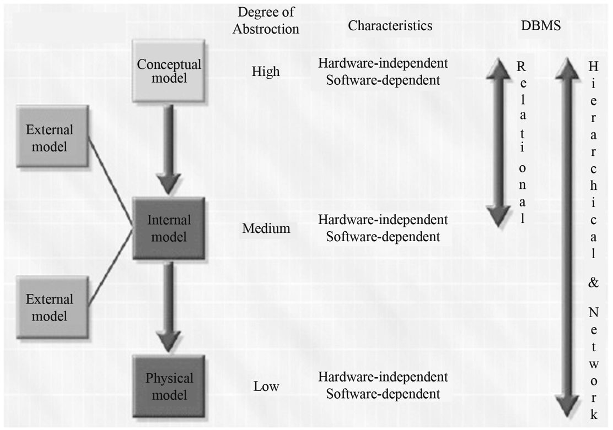
DEGREE OF DATA ABSTRACTION
ANSI/SPARC architecture defines three levels of data abstraction: External, Conceptual and Internal.

Slide 24
- The External Model : The external environment is the end users' view of the data. The end users view of data usually applies to their specific business needs and those of their organizational unit.
The benefits of representing the design through the external model are :
It is easier to identify the data needed by the end users.
It can be easily checked to ensure it is adequate and will support the processes, requirements, and constraints as defined
Through good design, security can be increased by only allowing users access to the subset of data that they need.

Slide 25
- The Conceptual Model : The conceptual model is created by taking all views and forming a global view of the entire database. The conceptual model is generally represented by E/R Diagrams. Another name for the conceptual model is the logical design of the database. The conceptual model represents a global view of the entire database as viewed by he entire organization i.e. it integrates all external views into a single global view of the data in the organization.
Benefits of the conceptual models are :
It provides macro-level view of the data environment.
It is independent of both software and hardware. Software independence state that the model does not depend on the DBMS software, and hardware independence means that the model does not depend on the hardware used in the implementation of the model.

Slide 26
-The Internal Model : The internal model can be created after a specific DBMS platform is chosen. The internal model is the database as seen by the specific DBMS. What sets the internal model apart from the external and conceptual is its reliance on its software platform. The goal in designing the internal model is to achieve logical independence, where the internal model can be changed without affecting conceptual model.
- The Physical Model : This is the final and lowest level of abstraction. This is the model which describes such implementation level design as how the data is stored on media and what media to use. This level of abstraction is reliant on software and hardware. This level is created last because designers will know the exact specifications of the database and can from there decide what exact hardware specs are needed. The goal of the physical level is to create a design where the physical model can be changed without affecting the internal model.

